Slide 1
Process Scheduling
Unit 1.2-Chapter 2

Slide 2
CPU Scheduling
Scheduling the processor among all ready processes
The goal is to achieve:
High processor utilization
High throughput
number of processes completed per of unit time
Low response time
time elapsed from the submission of a request until the first response is produced

Slide 3
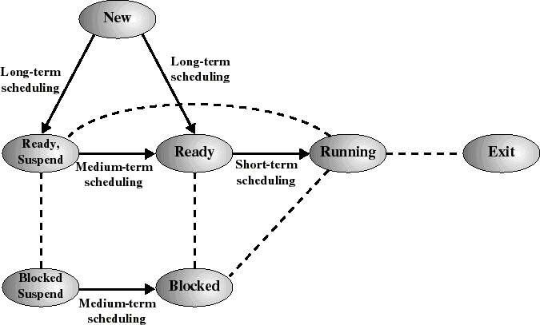
Classification of Scheduler
Long-term: which process to admit?
Medium-term: which process to swap in or out?
Short-term: which ready process to execute next?

Slide 4
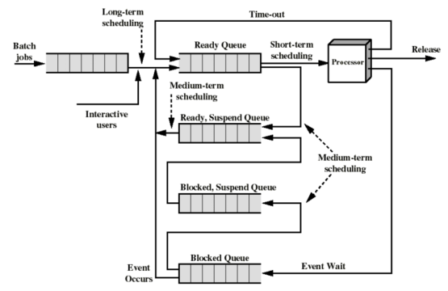
Queuing Diagram for Scheduling

Slide 5
Long-Term Scheduler
Determines which programs are admitted to the system for processing
Controls the degree of multiprogramming
Attempts to keep a balanced mix of processor-bound and I/O-bound processes
CPU usage
System performance

Slide 6
Medium-Term Scheduler
Makes swapping decisions based on the current degree of multiprogramming
– Controls which remains resident in memory and which jobs must be swapped out to reduce degree of multiprogramming

Slide 7
Short-Term Scheduler
Selects from among ready processes in memory which one is to execute next
The selected process is allocated the CPU
It is invoked on events that may lead to choose another process for execution:
Clock interrupts
I/O interrupts
Operating system calls and traps
Signals

Slide 8
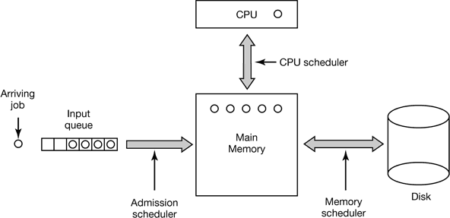
Three level scheduling
From a certain perspective, batch systems allow scheduling at three different levels, as illustrated in Fig
As jobs arrive at the system, they are initially placed in an input queue stored on the disk.

Slide 9
Three level Scheduling
The admission scheduler (long term scheduler) decides which jobs to admit to the system. The others are kept in the input queue until they are selected.
A typical algorithm for admission control might be to look for a mix of compute-bound jobs and I/O-bound jobs. Alternatively, short jobs could be admitted quickly whereas longer jobs would have to wait.
The admission scheduler is free to hold some jobs in the input queue and admit jobs that arrive later if it so chooses.

Slide 10
Three level scheduling(Cont)
Once a job has been admitted to the system, a process can be created for it and it can contend for the CPU.
However, it might well happen that the number of processes is so large that there is not enough room for all of them in memory. In that case, some of the processes have to be swapped out to disk.
The second level of scheduling is deciding which processes should be kept in memory and which ones kept on disk.
We will call this scheduler the memory scheduler (short term schedular), since it determines which processes are kept in memory and which on the disk.

Slide 11
Three level of scheduling(cont.)
The third level of scheduling is actually picking one of the ready processes in main memory to run next.
Often this is called the CPU scheduler and is the one people usually mean when they talk about the “scheduler.”
Any suitable algorithm can be used here, either preemptive or non-preemptive.

Slide 12
Classification of Scheduling(CPU) Algorithms
The selection function determines which ready process is selected next for execution
The decision mode specifies the instants in time the selection function is exercised
Nonpreemptive
Once a process is in the running state, it will continue until it terminates or blocks for an I/O
Preemptive
Currently running process may be interrupted and moved to the Ready state by the OS
Prevents one process from monopolizing the processor

Slide 13
Scheduling Criteria
User-oriented criteria
Response Time: Elapsed time between the submission of a request and the receipt of a response
Turnaround Time: Elapsed time between the submission
of a process to its completion
System-oriented criteria
Processor utilization
Throughput: number of process completed per unit time
fairness

Slide 14
Scheduling Algorithms
First-Come, First-Served(FCFS)
Shortest-Job-First(SJF) Scheduling
– Also referred to as Shortest Process Next(SPN)
Priority Scheduling
Round-Robin Scheduling
Multilevel Queue Scheduling

Slide 15
Process Mix Example
Process | Arrival Time | Service Time
1 | 0 | 3
2 | 2 | 6
3 | 4 | 4
4 | 6 | 5
5 | 8 | 2
Service time = total processor time needed in one (CPU-I/O) cycle Jobs with long service time are CPU-bound jobs and are referred to as “long jobs”

Slide 16
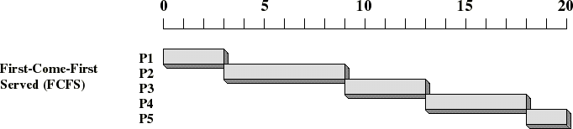
First Come First Served (FCFS)
Selection function: the process that has been waiting the longest in the ready queue (hence, FCFS)
Decision mode: non-preemptive
– a process runs until it blocks for an I/O

Slide 17
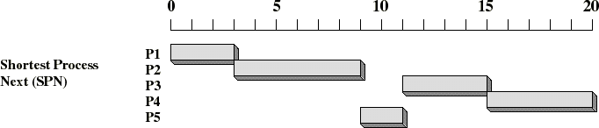
Shortest Job First (Shortest Process Next)
Selection function: the process with the shortest expected CPU burst time
– I/O-bound processes will be selected first
Decision mode: non-preemptive
The required processing time, i.e., the CPU burst time, must be estimated for each process

Slide 18
Priorities
Implemented by having multiple ready queues to represent each level of priority
Schedule the process of a higher priority over one of lower priority
Lower-priority may suffer starvation
To alleviate starvation allow dynamic priorities
– The priority of a process changes based on its age or execution history

Slide 19
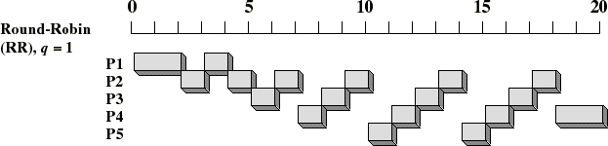
Round-Robin
Selection function: same as FCFS
Decision mode: preemptive
a process is allowed to run until the time slice period
(quantum, typically from 10 to 100 ms) has expired
a clock interrupt occurs and the running process is put on the ready queue

Slide 20
RR Time Quantum
Quantum must be substantially larger than the time required to handle the clock interrupt and dispatching
Quantum should be larger then the typical interaction
– but not much larger, to avoid penalizing I/O bound processes

Slide 21
Round Robin: critique
Still favors CPU-bound processes
An I/O bound process uses the CPU for a time less than the time quantum before it is blocked waiting for an I/O
A CPU-bound process runs for all its time slice and is put
back into the ready queue
May unfairly get in front of blocked processes

Slide 22
Round Robin Variants
Weighted RR
RR with variable quanta
Paper Based Study

Slide 23
Thank you very much

